Slide 1
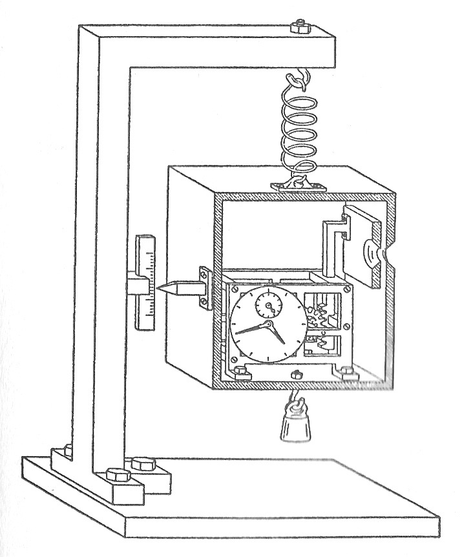
Quantum chaos and quantum measurement:
paradigms of quantum
entropy production
Thomas Dittrich Universidad Nacional de Colombia Oscar Rodríguez Bogotá

Slide 2
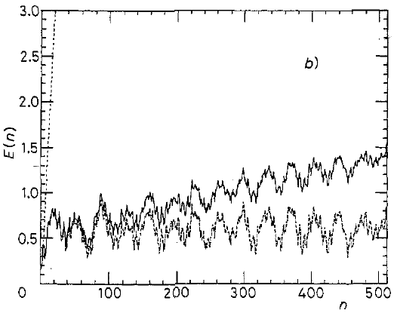
1 Classical bloom and quantum death of deterministic chaos
1.1 Quantum chaos and decoherence (a 1990 result)
Revival of angular-momentum diffusion in the quantum kicked rotor
with continuous momentum measurement
Trace 1:
Momentum-space diffusion
in the classical kicked rotor
Trace 2:
Suppression of classical chaos after a finite time t* in the quantum kicked rotor
Trace 3:
Recovery of chaotic energy growth in the observed quantum kicked rotor
1: classical
3: quantum with
measurement
E(t)
2: quantum
t*
t

Slide 3
1 Classical bloom and quantum death of deterministic chaos
1.2 There is no entropy production in closed quantum systems
Divergences of information content /
production in deterministic chaos …
Static structures:
Self-similar phase-space patterns
imply unbounded information density.
Dynamical scenario:
Chaotic time evolution permanently
“produces” entropy, lifting it from
invisibly small to large scales.
… are regularized in unitary
quantum mechanics
Static structures:
Quantum uncertainty limits the
resolution of phase-space structures.
Dynamical scenario:
In systems with a finite number of
freedoms, quantum time-evolution
eventually becomes (quasi-)periodic.
Fundamental bounds on the information content of isolated
quantum systems prevent permanent entropy production,
characteristic of deterministic classical chaos

Slide 4
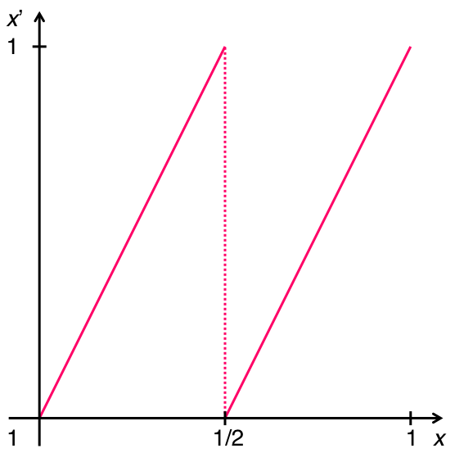
1 Classical bloom and quantum suppression of chaos
1.3 Breaking the splendid isolation
macro
entropy flow
micro
classical system

Slide 5
1 Classical bloom and quantum suppression of chaos
1.3 Breaking the splendid isolation
macro
entropy flow
micro
quantum system

Slide 6
1 Classical bloom and quantum suppression of chaos
1.3 Breaking the splendid isolation
macro
entropy flow
micro
quantum system

Slide 7
1 Classical bloom and quantum suppression of chaos
1.3 Breaking the splendid isolation
macro
entropy flow
micro
environment
environment
quantum system

Slide 8
1 Classical bloom and quantum suppression of chaos
1.3 Breaking the splendid isolation
macro
entropy flow
micro
environment
environment
quantum system

Slide 9
1 Classical bloom and quantum death of deterministic chaos
1.3 Breaking the splendid isolation
The limits quantum mechanics imposes with respect to
information measures apply only in strictly closed systems.
No real system is perfectly closed (or else we could not
observe it).
Any coupling, however weak, to an environment with a
(quasi-) continuous spectrum opens access to an external
source of entropy.
Paradigmatic cases are
decoherence (e.g., measurement) and
dissipation (e.g., friction).

Slide 10


2 Quantum measurement and quantum randomness
2.1 Spin measurements and randomness
... 001001101 ...
Stern-Gerlach
magnet
detectors
... 110110010 ...
sequence of identical
qubits in Schrödinger
cat states
random sequence
of classical bits in
σ_{z} eigenstates:
p(0)=p(1)=0.5

Slide 11
2 Quantum measurement and quantum randomness
2.2 Hypothesis
In spin measurement, one classical bit of information per detected
particle is produced “from nothing”.
Such entropy production is incompatible with deterministic
unitary time evolution of the spin alone.
Consider spin, meter, and environment as a closed system evolving
unitarily as a whole: The total information content is conserved!
If a bit is “created” in the measurement (“quantum randomness”), it
can only come from the macroscopic ensemble meter + environment.
Can it be the result of a unitary time evolution, depending on
the initial state of the full system, spin + meter + environment?

Slide 12
2 Quantum measurement and quantum randomness
2.3 Three steps of a quantum measurement (von Neumann)
Generate correlations between object and meter states
through a suitable coupling, typically local in time
Turn quantum superpositions into classical alternatives
“first collapse of the wave packet”
creates entanglement due to the coupling of the meter
to a macroscopic environment,
leaves the measured object in a mixed state,
which only specifies probabilities for the outcomes of the measurement
Turn classical alternatives into sequences of random events
“second collapse of the wave packet”
upon leaving the apparatus, the measurement object returns to
a pure state, one of the eigenstate of the measured observable

Slide 13
2 Quantum measurement and quantum randomness
2.3 Three steps of a quantum measurement
Entanglement is reciprocal!
As the measured system gets entangled with the apparatus and
its environment, information on the state of the measured system
is shared with the environment and recorded in it:
The environment as a witness.
By reciprocity of entanglement, information on the state
of the apparatus is also shared with the measured system.
In this way, the time evolution of the measured system must also
depend on the initial state of the environment.

Slide 14
2 Quantum measurement and quantum randomness
2.4 Information balance of quantum measurement
Before the measurement: object, meter and environment in pure states
During the measurement: object and meter entangled
with the environment
Note that the initial environment state is featureless so far.
After the measurement: object leaves in a pure state

Slide 15
2 Quantum measurement and quantum randomness
2.4 Information balance of quantum measurement
... 001001101 ...
... 110110010 ...

Slide 16
2 Quantum measurement and quantum randomness
2.4 Information balance of quantum measurement
... 001001101 ...
... 110110010 ...

Slide 17
2 Quantum measurement and quantum randomness
2.4 Information balance of quantum measurement
Partial entropy of the object
mixed
pure
pure

Slide 18
3 Numerical / experimental test
Measurement inside a closed cavity

Slide 19
3 Numerical / experimental test
3.1 Strategy
The finite heat bath approach, developed for decoherence and
dissipation in quantum optics and chemistry, treats system and
environment as one closed system with unitary time evolution.
Combine a model of decoherence in quantum measurement
à la Zurek et al. with the finite heat bath approach for meter +
environment.
Apply powerful algorithms for numerical simulation of the unitary
time evolution of object + (meter + environment).
Increase the number N of heat bath modes as far as possible.
Register the dependence of the measurement results
on the initial state of meter + environment.

Slide 20
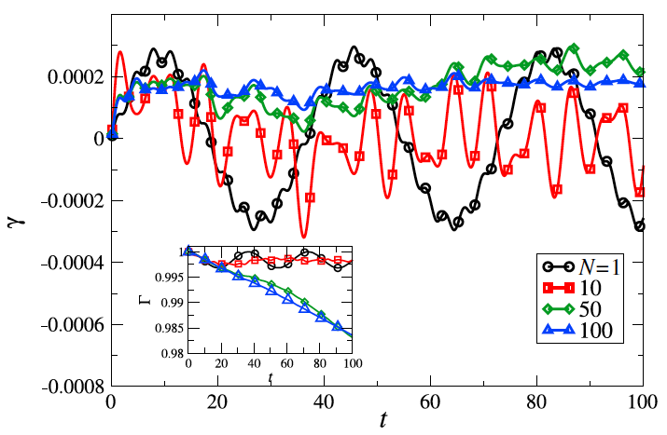
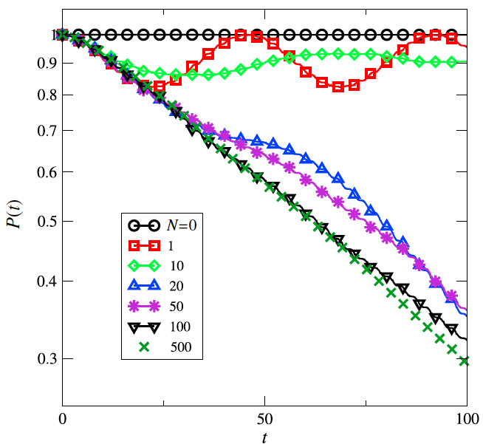
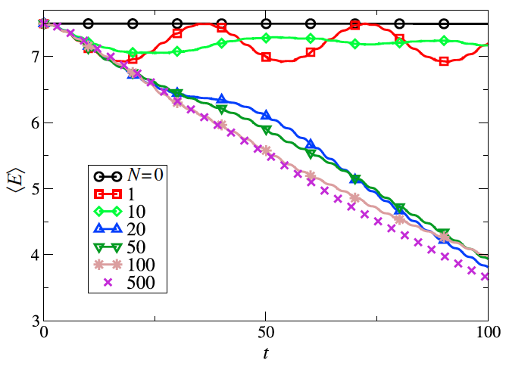
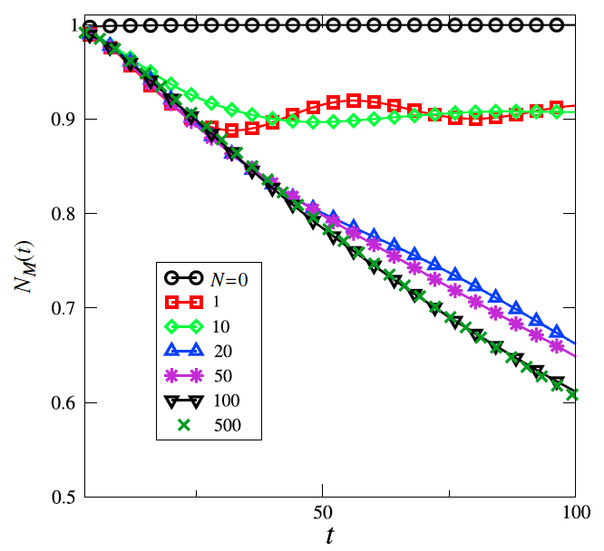
3 Numerical / experimental test
3.2 Finite heat bath approach
A parallel case: decoherence in a harmonic oscillator + finite bath*
time-dependent dissipation rate purity
energy decay non-Markovianity
*M. Galiceanu, M. W. Beims, W. T. Strunz: “Quantum energy and coherence exchange
with discrete baths”, Physica A 415, 294 (2014).

Slide 21
3 Numerical / experimental test
3.3 Protocol
Prepare the object system in a neutral (Schrödinger cat) state
with respect to the observable to be measured
(for example, in an eigenstate of or , if will be measured).
Perform measurements with a meter that comprises a large but finite
number N of degrees of freedom (bath modes)
Register the evolution and the outcome of the measurements as they
vary with growing N,
observe how, as N → ∞, a typical few-body quantum dynamics (e.g.,
collapses and revivals), crosses over to that of a measurement with
a definite result that depends on the initial state of the meter.

Slide 22
3 Numerical / experimental test
3.4 Quantum model
Hamiltonians (spin-boson model with N boson modes)
Initial state

Slide 23
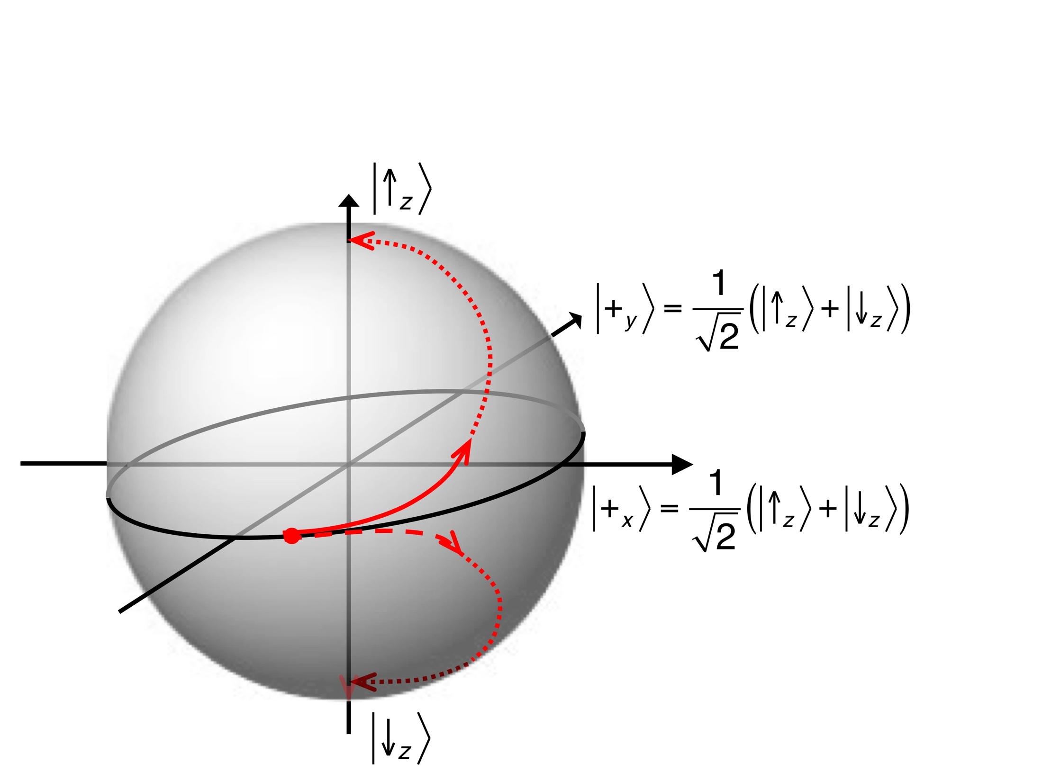
3 Numerical / experimental test
3.4 Quantum model
Expected initial time evolution of the state vector on the Bloch sphere

Slide 24

3 Numerical / experimental test
3.5 Numerical results for N = 1
Time evolution of the reduced density matrix of the spin, represented
on the Bloch sphere, numerical simulations for ω₀ = 1.0, N = 150

Slide 25
4 Einstein ...
“God does not throw dice.”
Yes He does.
But they fall deterministically.

