Slide 1
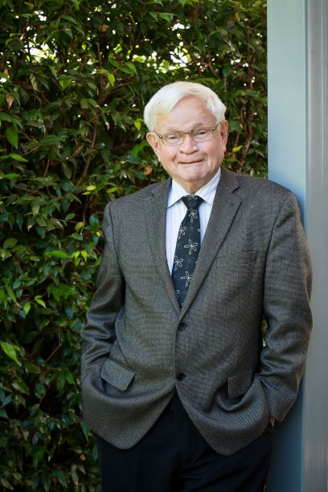
Action and entropy in heat engines: A modern revision of the Carnot cycle
Entropy 2021
Porto, Portugal
Ivan R Kennedy and Migdat Hodzic
University of Sydney, Sydney NSW Australia
American University in Bosnia and Herzogovina, Sarajevo
Kennedy et al 2019, Entropy 21,454
A simple method to estimate entropy and free energy
of atmospheric gases from their action

Slide 2

Making thermodynamics easier using the least action principle
Kennedy IR Action in Ecosystems Wiley 2001
Least action is nature’s statistical means for economy of energy resources S = ʃ(T – V)dt - integrating the Lagrangian w/r time
Partition functions of statistical mechanics can be interpreted as ratios of action compared to Planck’s quantum of action ћ
In revising the Carnot cycle, can we discover anything new from the idea of action to apply to the greatest issue of our time – climate change

Slide 3
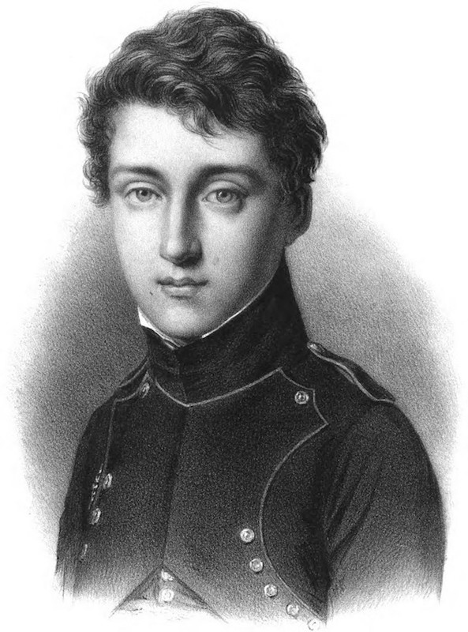
Sadi Carnot’s legacy
Carnot’s legacy is often still misunderstood, given Lord Kelvin was misled by Clapeyron’s paper that the cycle assumed conservation of caloric between the extremes of temperature. Clausius was deceived too, but generously corrected Carnot’s “error” in 1850
In fact, as we will show here, there was no such error. Richard Feynman in his lectures also concluded there was no error and that the Clausius-Clapeyron equation should really be called the Carnot equation, since it was already described in Carnot’s 1824 memoire
Using an action revision can we obtain a better understanding of Carnot’s cycle?

Slide 4
Carnot’s postulates
“The motive power of heat is independent of the agents employed to realize it; its quantity is fixed solely by the temperatures between which is effected, finally, the transfer of caloric”
“When a gas varies in volume without change in temperature the quantity of heat absorbed or liberated are in arithmetical progression if the increments or decrements of volume are in geometrical progression”
“The temperature is higher during the movements of dilatation than during the movements of compression. During the former the elastic force of air is found to be greater and consequently the quantity of motive power during dilatation is more considerable than that consumed to produce movements of compression”
“The quantities of heat absorbed or set free in these different transformations are exactly compensated”

Slide 5
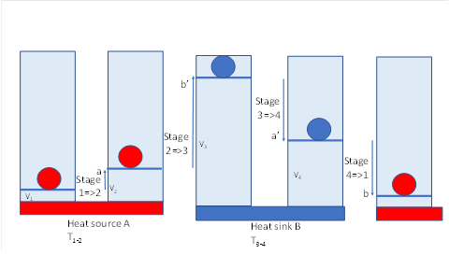
Four stages of Carnot cycle
Stage 1=2: Isothermal Carnot’s caloric a
Stage 2=3: Adiabatic b’
Stage 3=4: Isothermal a’
Stage 4=1: Adiabatic b
Q₁₋₂ = W₁₋₂ = RT_{1,2}ln(V₂/V₁)
W₂₋₃ = Cv(T₂-T₁)
-Q₃₋₄ = W₃₋₄ = RT_{3,4}ln(V₄/V₃)
W₄₋₁ = Cv(T₁-T₂)
W = R(T₁-T₂)ln (V₂/V₁)
ϒ = (Q₂ – Q₁)/ Q₂
= (T₂ – T₁)/T₂

Slide 6
Action @ = ʃmvds = mvrδφ
- a scalar property similar to angular momentum
p = kT/a³ = NkT; a = 2r
pa³ = kT = mv²/3 = mr²ω²/3
@ = mr²ω
@ relative action (per radian)
2r
2r

Slide 7
Action space = Phase space dp.dq
Gibbs’ extension in phase
Translational relative action
Rotational relative action
Diatomic
@_{r}² = (2kTI)/σ = (Iω)²
Polyatomic
@_{ra}@_{rb}@_{rc} = [(2kTI_{a})^{0.5}(2kTI_{b}) ^{0.5}(2kTI_{c})^{0.5}/σ]
σ symmetry factor
@_{t}³ = [(3kTI_{t})^{1.5}/z_{t})= mrv
    I = mr²
z_{t} = (2)³(1.0854)³ = 10.2297
Mean velocity/RMS velocity
= v/ū = 1/1.0854
2³ symmetry factor

Slide 8
Entropy from relative action s = (h-g)/T
Translational
-g_{t} = kln[(@_{t})/ħ)³ = kln[n_{t})³
  Rotational
-g_{r} = kln[(@_{r})/ħ)² = kln[j_{r})² - diatomic
-g_{r} = kln[(@_{ra})/ħ) (@_{rb})/ħ)(@_{rc})/ħ) = kln[j_{ra}x j_{rb}x j_{rc})
                - polyatomic

Slide 9
Entropy of N₂
s = 3.5k + kln[n_{t})³ + kln[j_{r})²
Entropic energy = sT
sT = 3.5kT + kTln[n_{t}]³ + kTln[j_{r}]²
sT = kTlne^{3.5}{[n_{t}]³ [j_{r}]²}
= h – g
g = h - sT

Slide 10
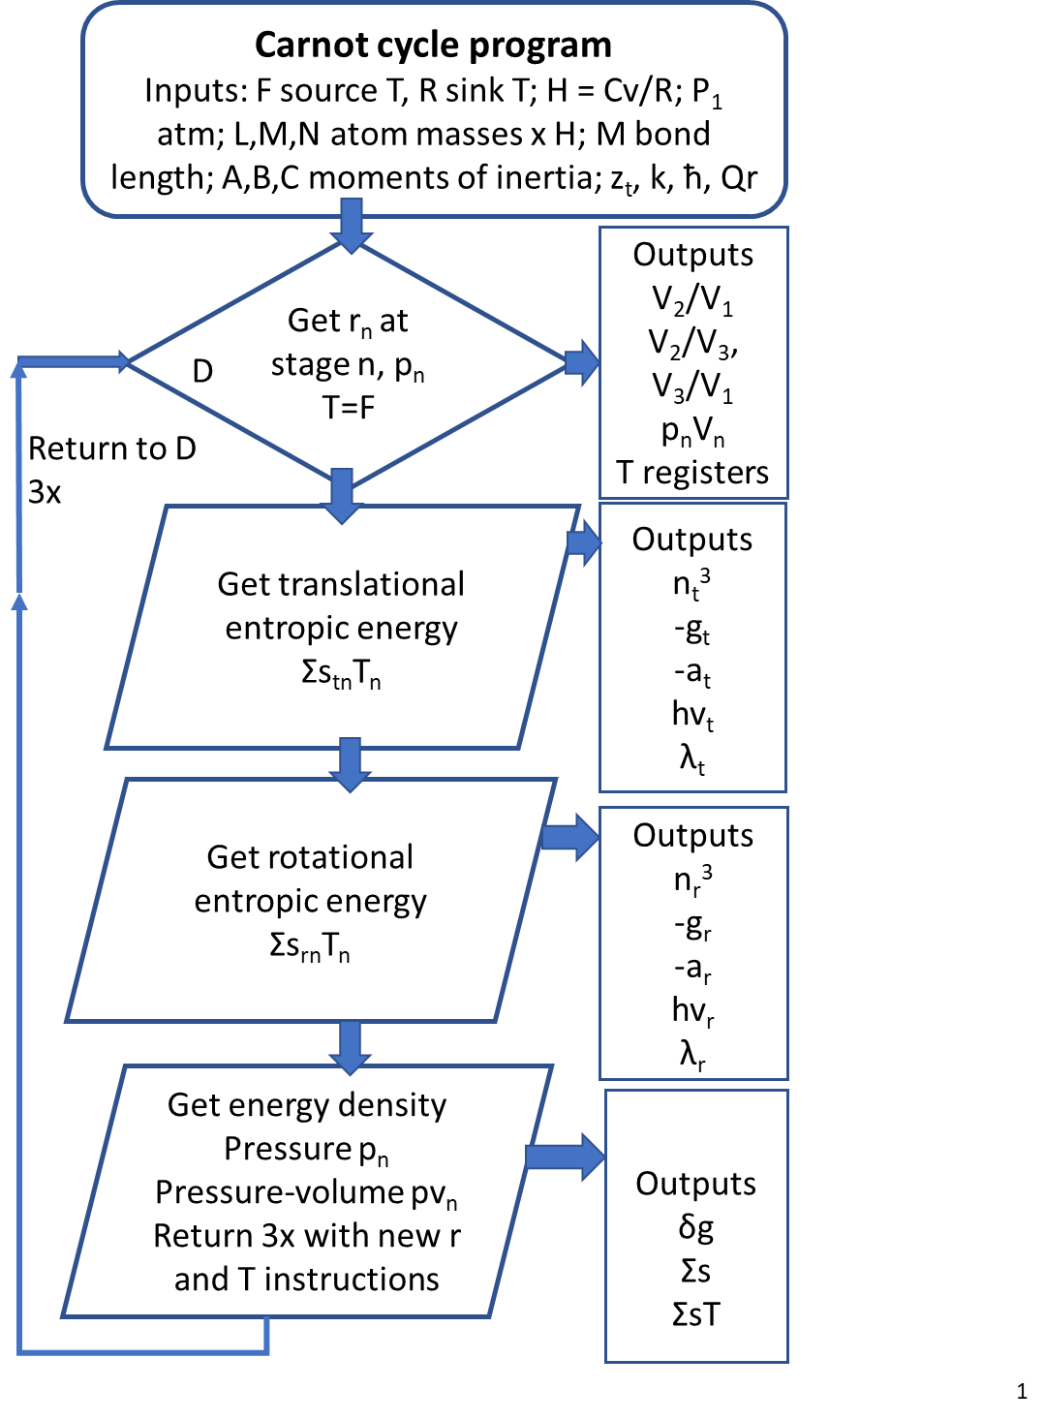
Flow sheet for computation
Program code available from ivan.kennedy@sydney.edu.au

Slide 11
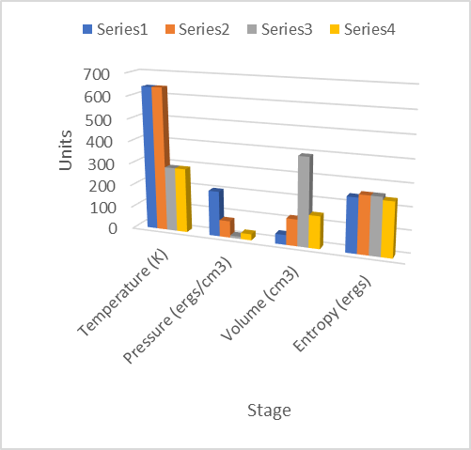
Carnot cycle stages
ARGON -G, ST and E
T, p, V, S

Slide 12
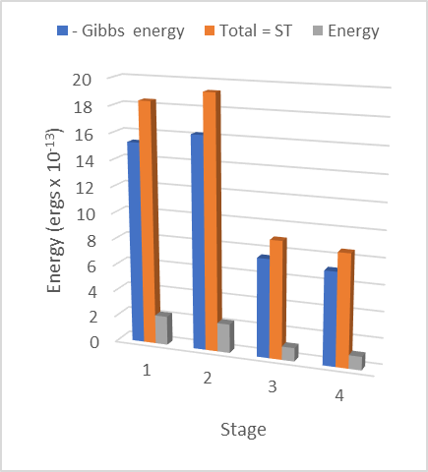
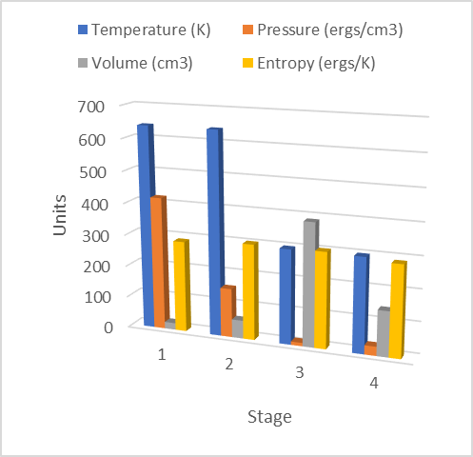
N₂ as working fluid

Slide 13
-Gibbs energies or configurational entropic energy
ARGON | Stage 1=2 | Stage 2=3 | Stage 3=4 | Stage 4=1
Action @_{t} (Iω erg.sec) | 8.441202x10⁻²⁶ | 1.178065x10⁻²⁵ | 1.178065x10⁻²⁵ | 8.441202x10⁻²⁵
Quantum number | n = 80.042 | n = 111.708 | n = 111.708 | n =80.042
hv | 1.4154 x 10⁻¹⁴ | 1.1191x 10⁻¹⁴ | 5.036 x 10⁻¹⁵ | 6.531 x 10⁻¹⁵
-Gibbs energy (-g) | 11.617287 x10⁻¹³ | 12.500888x10⁻¹³ | 5.625399x10⁻¹³ | 5.227779x10⁻¹³
δGibbs energy (δg) | -0.8837 x10⁻¹³ a | +6.875489 x10⁻¹³ b’ | +0.39762x10⁻¹³ a’ | -6.389508 x10⁻¹³ b
NITROGEN | Stage 1=2 | Stage 2=3 | Stage 3=4 | Stage 4=1
Translational action @_{t} (Iω erg.sec) | 7.062416x10⁻²⁶ | 9.856396x10⁻²⁶ | 1.118839x10⁻²⁵ | 9.216142x10⁻²⁶
Virtual quantum no. | n_{t} = 66.968 | n_{t} = 93.462 | n_{t} = 121.963 | n_{t} = 87.391
-g_{t} (ergs) | 1.114455x10⁻¹² | 1.202815x10⁻¹² | 5.730170x10⁻¹³ | 5.332550x10⁻¹³
hv_{t} | 1.664154x10⁻¹⁴ | 1.286960x10⁻¹⁴ | 4.698270x10⁻¹⁵ | 6.1019722x10⁻¹⁵
Rotational action @_{r} | 1.118839x10⁻²⁶ | 1.118839x10⁻²⁶ | 7.505400x10⁻²⁷ | 7.50540x10⁻²⁷
Rotational free energy | 4.173639x10⁻¹³ | 4.173639x10⁻¹³ | 1.560635x10⁻¹³ | 1.560635x10⁻¹³
–Gibbs energy ergs/molecule (-g_{t} – g_{r}) | 1.531819x10⁻¹² | 1.620179x10⁻¹² | 7.290805x10⁻¹³ | 6.893185x10⁻¹³
δGibbs energy | -0.88360x10⁻¹³ a | +8.910985x10⁻¹³ b’ | +0.39762x10⁻¹³ a’ | -8.425005x10⁻¹³ b
hv_{r} | 3.933976x10⁻¹⁴ | 3.933976x10⁻¹⁴ | 2.192865x10⁻¹⁴ | 2.192865x10⁻¹⁴
Relative action = @
Quantum number = @/ħ = n_{t}
Gibbs energy = -kT(n_{t})³
Virtual quanta = hv = -g_{t}/n_{t}
Work = a - a’ for both positive

Slide 14
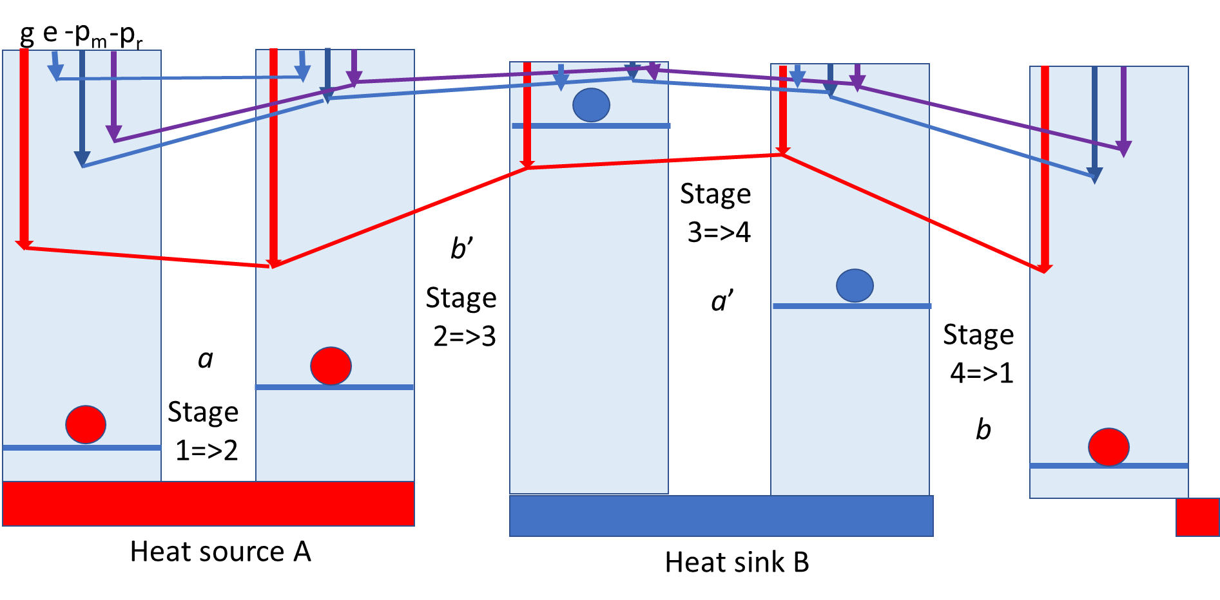
Carnot caloric cycle
ןa + b ן = ן b’ + a’ן
ןa – a’ן = ןb’ – bן = maximum work possible
Efficiency = (a – a’)/a = (Q_{f} – Q_{r})/Q_{f} = (T_{f} – T_{r})/T_{f}

Slide 15
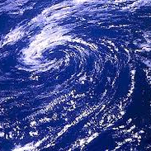
Carnot’s legacy is confirmed by this action based analysis
Carnot’s postulates of the independence of working fluid, the importance of temperature gradient and the logarithmic effect of volume on specific heat are all logically modelled as action thermodynamics.
Carnot’s (Clausius-Clapeyron) equation regarding the heat of vaporization even predicted the difference in vapour pressure of water at different temperatures, an important feature of climate science
Consistency of his analysis with action thermodynamics suggests that all ensembles of molecules in relative action should infer sustaining negative Gibbs energy or entropic energy
Can we recognise the heat-work-heat processes of a Carnot cycles in climate

Slide 16
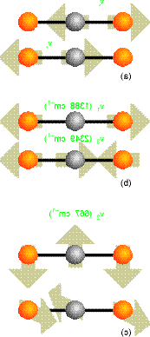
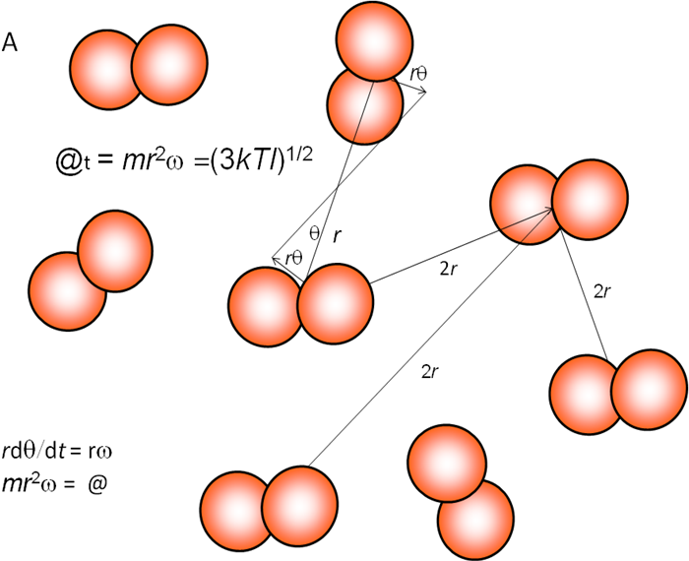
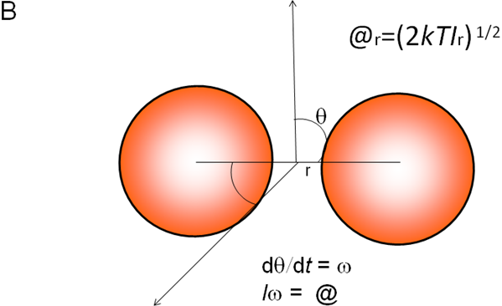
CALCULATING ENTROPY AS A FUNCTION OF ACTION (MRVδφ)
Translational
Vortical
Vibrational
Rotational
Vortical action
@_{r} = mr_{r}v_{r}
S_{r} = Rln[e(8π²kTI_{r}/σ_{r}h²)]
S_{r} = Rln[e(@_{r}/ħ)²/σ_{r}]
= R + Rln[(@_{r}/ħ)²/σ_{r}]
S_{r} = Rln[π^{1/2}e^{3/2}(@_{A}@ _{B}@_{C}/ ħ³)/σ_{r}]
Anticyclone
Cyclone
@_{t} = mr_{t}v_{t}
S_{t} = Rln[8e^{5/2}(2πmr_{t}²kT)^{3/2}/h³]
S_{t} = Rln[8e^{5/2}(2πmr_{t}²kT)^{3/2}/h³]
S_{t} = Rln[e^{5/2}(@’_{t}/ħ)³/z_{t}]
= Rln[e^{5/2}(@_{t}/ħ)³] = Rln[e^{5/2}(n_{t})³]
S_{t}T = RTln[e^{5/2}(@_{t}/ħ)³]
Translational entropic energy
@_{vor} = mR²Ω
S_{vor} = Nkln(mR²Ω/ħ)
S_{vor}T = Vortical potential energy
N_{r}/N_{s} = e^{−Er/kT}/e^{−Es/kT} = e^{−δE/kT}
−δE = −kTln(N_{r}/N_{s}) = −kTln(r_{s}/r_{r})³ = −kTln(@_{s}/@_{r})³
S_{vib} = (E−G)/T = Rxe^{−x}/(1−e^{−x}) − Rln(1−e^{−x})
S_{ν} = ΣSν_{i}
S_{ν}T = ΣSν_{i}T = Vibrational entropic energy
ΣS = ΣS_{νi}+ S_{rot} + S_{trans} + S_{vor} – increases heat capacity of air several times

Slide 17
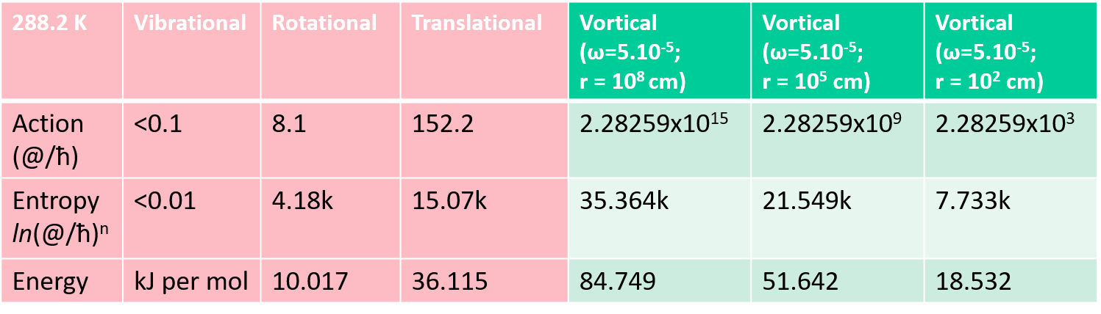
Heat capacity or specific heat in air of cyclonic and anticyclonic motion
Thus, with vortical configurational entropy, heat capacity is ca. three times greater,
effectively a capacitor providing a major source for heat-work-heat cycling

Slide 18
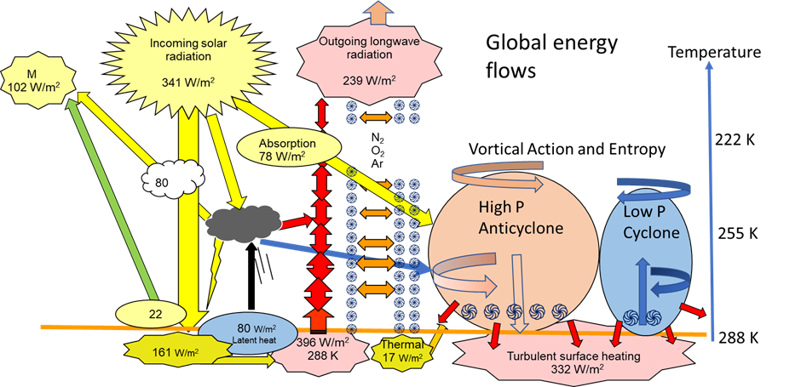
Vortical entropic energy coupled to Trenberth energy budget
This is a testable hypothesis

Slide 19


Conclusions
Not only is his establishment of the second law of thermodynamics clear, but the first conservation law of reversible heat and work is established in his equation for caloric establishing the pussiance motrice = (a – a’)
Carnot’s temperature-sensitive caloric can be taken as a primitive view of the work of Clausius, Boltzmann, Gibbs, Planck and Einstein’s quantum or action field
The second law of increasing entropy and energy dissipation is also recognised in the proposing cyclonic vortical entropy as a heat-work-heat cycle, as proposed in this presentation

