Slide 1
Application of Rényi entropy-based 3D electromagnetic centroids to segmentation of fluorescing objects in tissue sections
Renata Štysová-Rychtáriková et al.
Laboratory of Experimental Complex Systems
Institute of Complex Systems
Faculty of Fisheries and Protection of Waters
University of South Bohemia in České Budějovice
Entropy 2021, 05/05−07/2021

Slide 2
1. Theoretical assumptions
Extended Nijboer-Zernike Theory
Multifractality
+
2. Technical solutions
Small camera pixel
Primary vice-bit camera signal
Short z-step
Strong light illumination
Rychtáriková et al., Ultramicroscopy, 2017.
Notes:
We generalized the light superresolution/superlocalization which we respect in microscope production/construction
by combination of
Extended Nijboer-Zernike Theory which is according to our knowledge the most comprehensive description of the electromagnetic field arising from observation of realistic (thick and inhomogenous) sample, for the last time published in 2015.
And multifractality approach considering Rényi´s probability

Slide 3
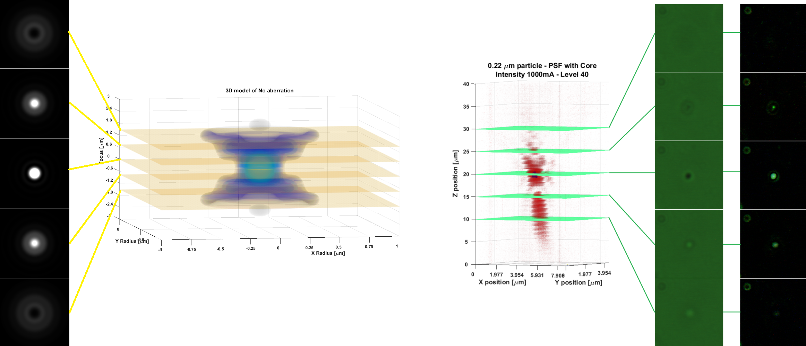
Extended Nijboer-Zernike Theory
+ Theory of Electromagnetic Centroid
Volume electromagnetic centroid:
intensity extreme
the same intensity in two consecutive images
Rychtáriková et al., Ultramicroscopy, 2017.
Notes:
By extension into 3D:
By comparison of two consecutive images in z-stack and finding the local intensity extreme, we can find a representation of the response of the interaction of light with a sample followed by interaction of the light with the optical path which we call the electromagnetic centroid. This electromagnetic centroid is the brightest point in fluorescence and the darkest point in diffraction. In both cases, it is a point of rare intensity.
Compared with the electromagnetic centroid obtained by the Gaussian fitting of the signal in 2D (known from 80s of the 20th century), we deal with the voxel-sized representation.

Slide 4
Multifractality approach: Point Divergence Gain Ω_{α}^{(L→M)}
I_{b} = (I+1)
(x,y), L
I_{a} =(I)
(x,y), M
Two consecutive z-stack images
Rychtáriková et al., Entropy, 2018.
Notes:
To respect the discretization of the light signal by the digital camera chip,
we used the approach of multifractal mathematics, probability, and information theory.
By exchange of the pixel intensity in the image histogram for the pixel intensity at the same position in the consecutive image we obtained a variable whcih we called a Point Divergence Gain

Slide 5
Multifractality approach: Point Divergence Gain Ω_{α}^{(L→M)}
Difference of two Rényi entropies:
$$Ω_{α}^{(L→M)}= \frac{1}{1−α}\log_{2}{\sum_{i=1}^{j}{{\left(p_{i}^{(L→M)}\right)}^{α}}−}\frac{1}{1−α}\log_{2}{\sum_{i=1}^{j}{{\left(p_{i}\right)}^{α}}}$$
.
.
.
$$Ω_{α}^{(L→M)}= \frac{1}{1−α}\log_{2}\left[\frac{{\left(n_{L}−1\right)}^{α}−n_{L}^{α}+{\left(n_{M}+1\right)}^{α}−n_{M}^{α}}{C_{α}}+1\right]$$
Specific case α = 2 (the Rényi collision entropy)
Taylor s.
$Ω_{2}^{(L→M)}=\frac{1}{1−α}\log_{2}\left[\frac{2}{C_{2}}\left(n_{M}−n_{L}+1\right)+1\right]≈A\left(n_{M}−n_{L}\right)$+B
i – value of intensity
M – pixel intensity in the first image (I)
L – pixel intensity in the following image (I+1)
j – number of intensities occupied in the image
p_{i} – probability of the occurrence of intensity i in the image
n_{i} – number of the occurrence of intensity i in the image
α – the Rényi dimensionless coefficient (α ≥ 0, α ≠ 1)
$C_{α}=\sum_{i=1}^{j}{n_{i}^{α}}$ – constant for intensity distribution of image (I)
Rychtáriková et al., Entropy, 2018.
Notes:
Which is indeed a subtraction of two Rényi information entropies:
That for the original image histogram and
that where one of the original pixel intensity M has been exchanged for the pixel of the intensity L.
The work with multifractal distributions/histograms is ensured by the coefficient α. Its low values (below 1) enable us to separate rare 3D points, its higher values (under the value of 2) enable us to gradually assign one value of α to a larger range of „rare“ intensity differences.
By the next mathematical treatment, we obtain a term which, for a given intensity histogram, depends only on the numbers of pixels of the intensities between which the exchange occurs.
This term says the PDG is no more information entropy but we are indeed dealing with a generalized information subtraction of two consecutive vice-dimensional datasets, i.e.., digital images in this case.
The best example is PDG for α = 2, its approximation is just a simple subtraction of two datasets.

Slide 6
Multifractality approach
Point Divergence Gain Entropy I_{α}:
$$I_{α}\left(I_{a};I_{b}\right)=\sum_{i=1}^{n}{\left|Ω_{α}^{a_{i}→b_{i}}\right|}=\sum_{L=1}^{j}{\sum_{M=1}^{j}{n_{lm}\left|Ω_{α}^{L→M}\right|}}$$
Point Divergence Gain Entropy Density P_{α}:
$$P_{α}\left(I_{a};I_{b}\right)=\sum_{L=1}^{j}{\sum_{M=1}^{j}{Χ_{lm}\left|Ω_{α}^{L→M}\right|}}$$
$$X_{lm}=1, { n}_{lm}≥1$$
$$X_{lm}=0, { n}_{lm}=0$$
$I_{a}=\left\{a_{1},…, a_{n}\right\}$ and $I_{b}=\left\{b,…, b_{n}\right\}$ – two consecutive one-dimensional data frames with pixel indices a_{i} and b_{i}, respectively.
n_{lm} – number of substitutions l→m at transformation I_{a}→I_{b}
Rychtáriková et al., Entropy, 2018.
Notes:
By summation of the absolute values of PDGs of the tranformed image, we can obtain two additive variables which measure a total information change between two consecutive datasets/digital images:
The PDGE includes all PDGs in the transformed dataset, whereas
the PDGED includes each individual value PDG just once (and is, therefore, smaller or equal to the PDGE).

Slide 7
Ω_{α}^{(L→M)} in microscopy image processing
1. 3D segmentation
Finding „volume electromagnetic centroid“
Movements detection
2. Image classification
- Finding in-focus region/image
Notes:
By application of our multifractal statistics using PDG in the processing the microscopic image data, we can filter the signal and, in this way,
we can find the voxel-sized electromagnetic centroid representing the information about the observed object as the „unchanged“ rare intensities in the image, or in other words,
To detect the movements/changes in the image sequences as the points of the highest values of the PDGs.
The additive variables (entropy and entropy density) uniquely describes the information change in the image sequence by one value of α or by a set of α values. In other words, these variebles are able to detect a slight spectral changes in the course of point spread function and are, therefore, suitable for finding the set of images where at least one point is in the focus or, as the extreme value of PDGE/PDGED, the „information-entropic“ focus itself. This focus can be different from this which is standardly find the Fourier transform.
Since we deal with the multifractality of the distribution, our filtering approach is a more general alternative to the standard Gaussian filtering.

Slide 8
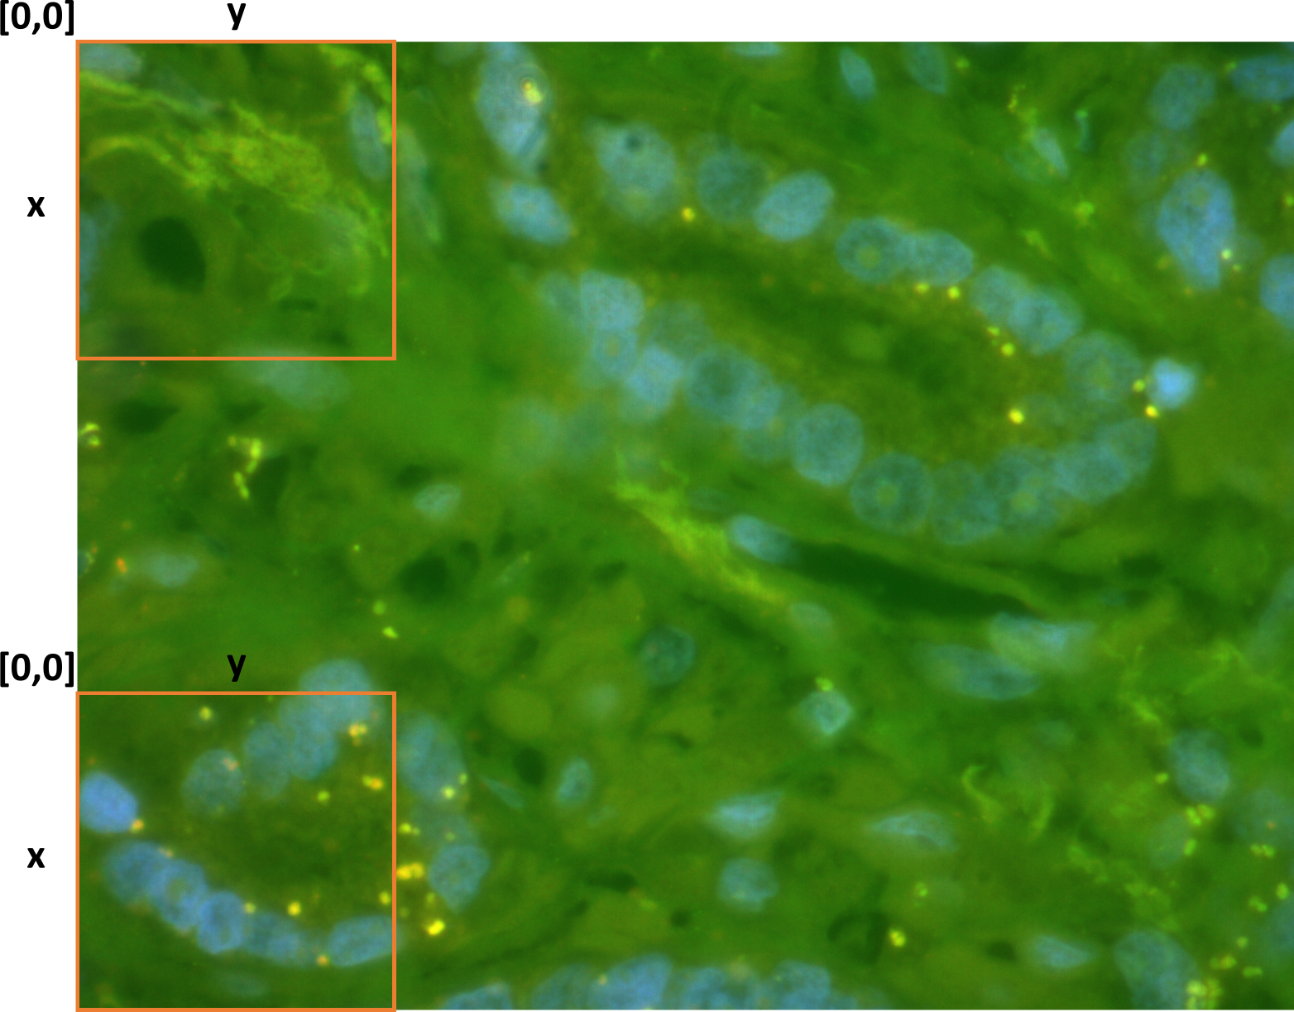
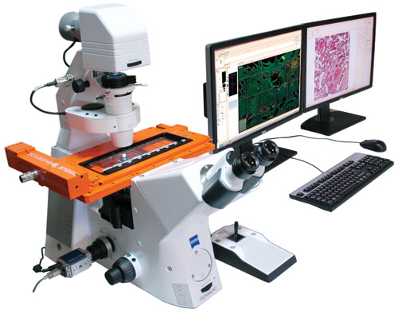
Application in fluorescence microscopy
Prostate cancer tissue section
DAPI, red, and green autofluorescence
Pixel size 328×328 nm²
Wide-field mode
TissueFaxs-PLUS-Confocal fluorescence microscope
(TissueGnostics, Vienna, AT)
Rychtáriková et al., Arxiv 1709.03894, 2017.
Notes:
We obtained a 16-bit data from a TissueFaxs-PLUS fluorescence microscope by Vienna company TissueGnostics. Despite this we are still not sure if this data really contains a primary camera signal.
It is a 3-channel z-stack with the step of 100 nm. In red and green channel we can observe autofluoresce, whereas in the blue channel we can see inserted fluorescence – DAPI bounded to DNA. The autoflurescence data are a control experiment which can be always done. In autofluorescence, the fluorophores are always specially bound to proteins. In the sample, there are no accidently scattered autofluorophores. We used this data to verify our method.
Despite a relatively large size of the pixel (>300 nm) which does not fulfill a rule of superresolution, our method of calculation of PDG was still successful in filtering the image. The reason is that, independently on the size of the pixel, we still deal with one example of multifractality.
After calculation of the PDGE, we firstly aligned the focuses of all colors and find sub-stacks of in-focus images. In these substacks, we found electromagnetic centroids.

Slide 9
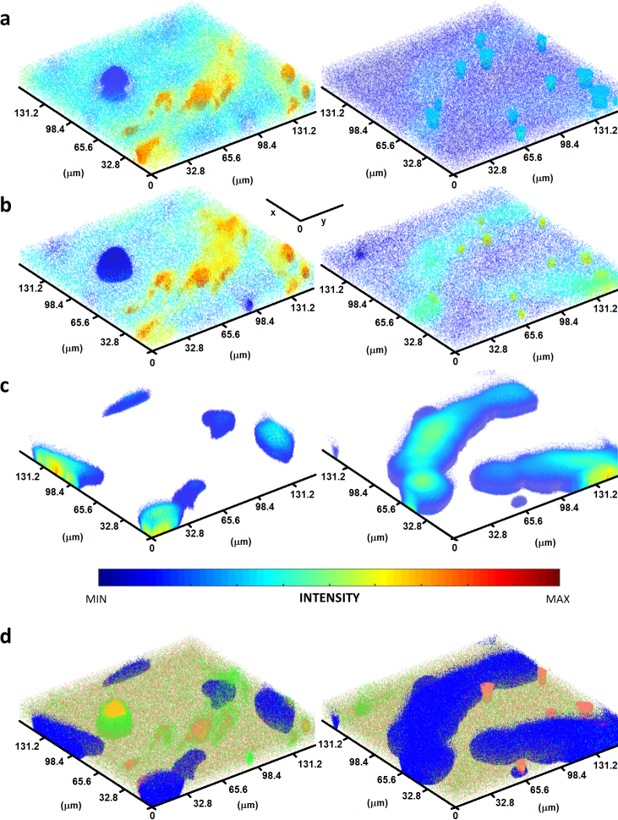
3D fluorescence microscopy
Red AF (Ω_{α} = 6)
Green AF (Ω_{α} = 6)
DAPI (Ω_{α} = 7)
colocalization
red autofluorescence, green autofluorescence, DAPI, red autofluorescence + green autofluorescence, red autofluorescence + DAPI, green autofluorescence + DAPI, and red autofluorescence + green autofluorescence + DAPI
Rychtáriková et al., Arxiv 1709.03894, 2017.
Notes:
In this way, I created a 3D map of electromagnetic centroids of fluorophores which was underwent my effort to further filter the signal in each color channel. This helped me to understand the (bio)chemistry in the cell. To find which type and concentration of fluorophores I have in the volume of the voxel:
The autofluorescence is homogenously spread in the volume of the cells.
In case of inserted fluorescence, the signal has a medium intensity and is separated, we assigned this to background.
When the signal is a medium intensity but concentrated in neighbouring pixels, it is probably an unspecific bound.
When the signal is strong and concentrated, we probably observe a specific bound of a high quentum efficiency, or, in the voxel, there could be contained more fluorophores of the same type and substantially far each from the other to avoid the autobleaching.

Slide 10
Outline of calculation
STEP 1
$$Ω_{50}^{(L→M)}$$
Background subtraction
STEP 2
$$Ω_{10}^{(L→M)}$$
$$Ω_{2}^{(L→M)}$$
3D map of electromagnetic centroids
3D PSFs
Object intensity classification

Slide 11
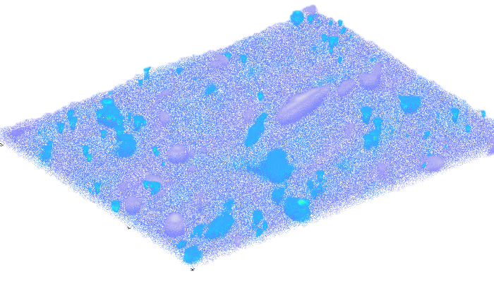
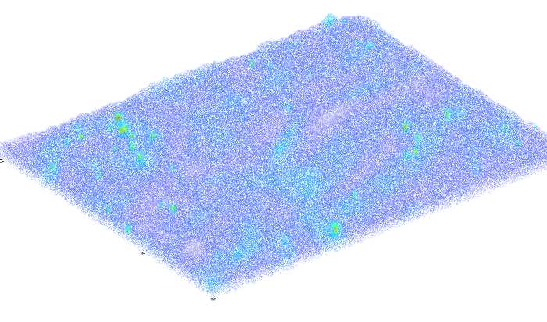
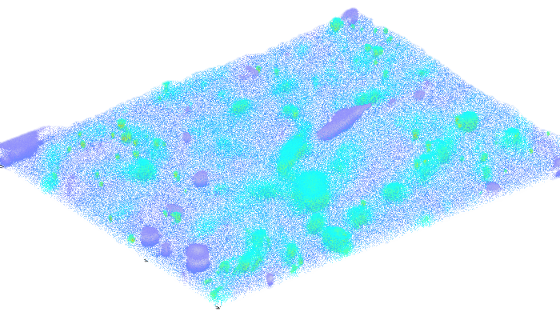
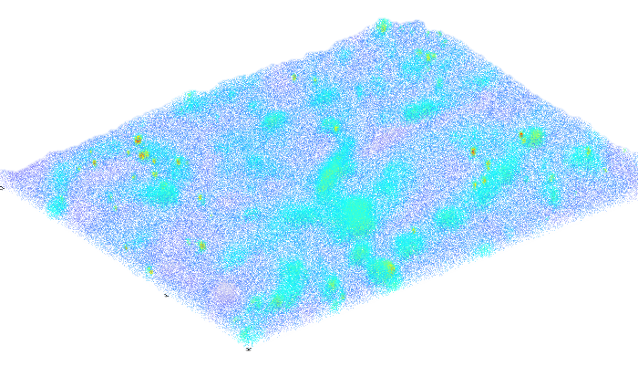
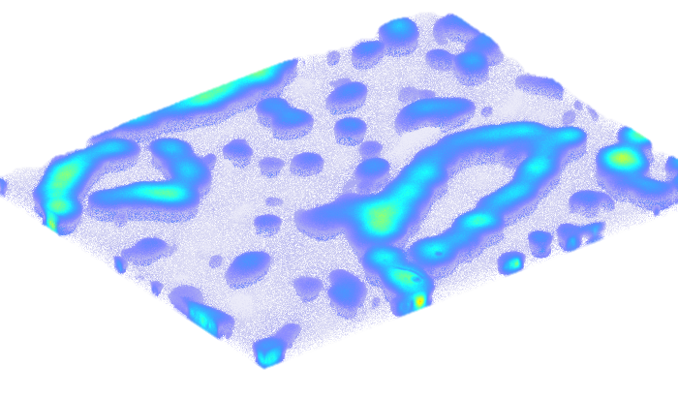
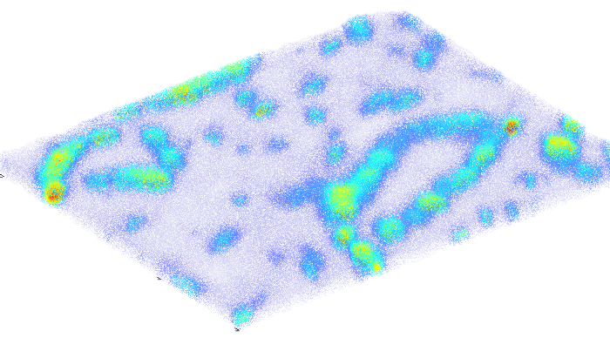
α = 10
PSF
α = 2
VEC
RAf
GAf
DAPI

Slide 12
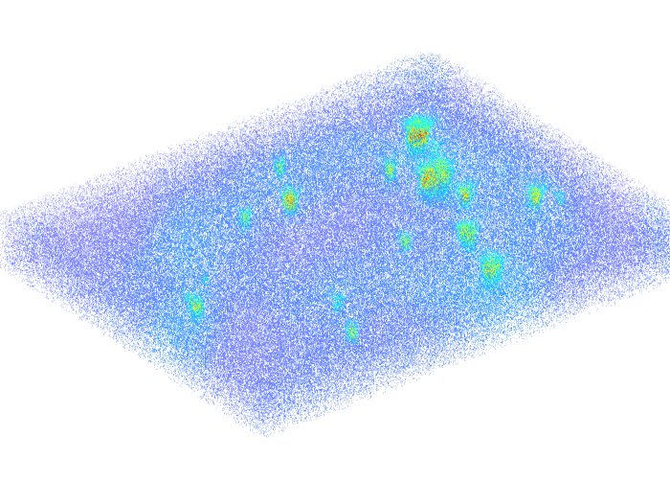
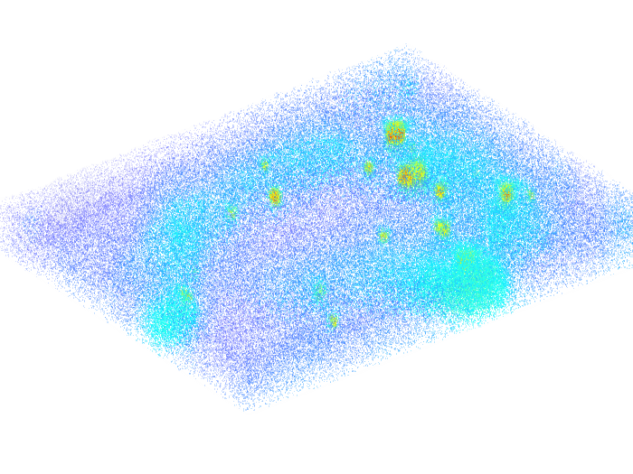
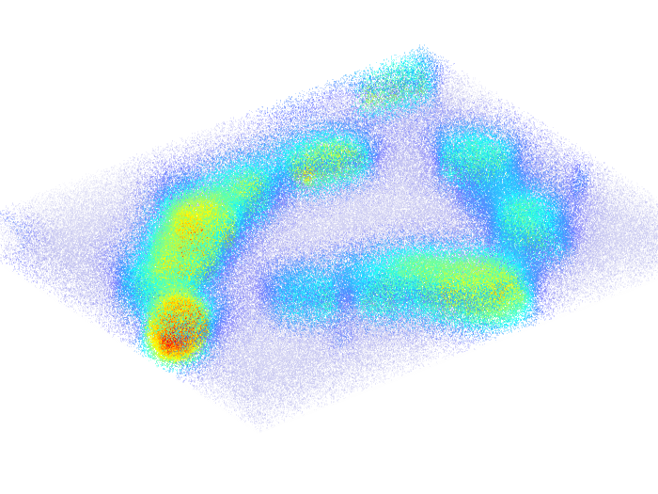
RAf
GAf
DAPI

Slide 13
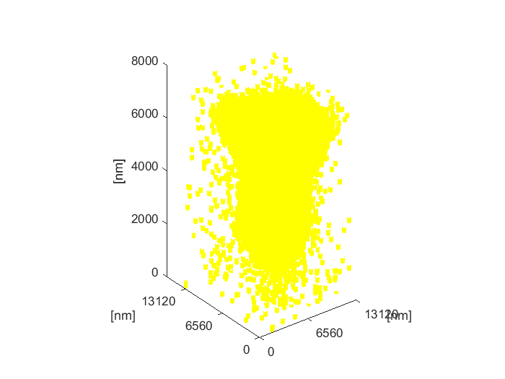
PSFs
RAf

Slide 14
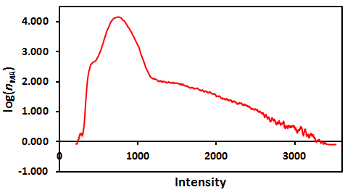
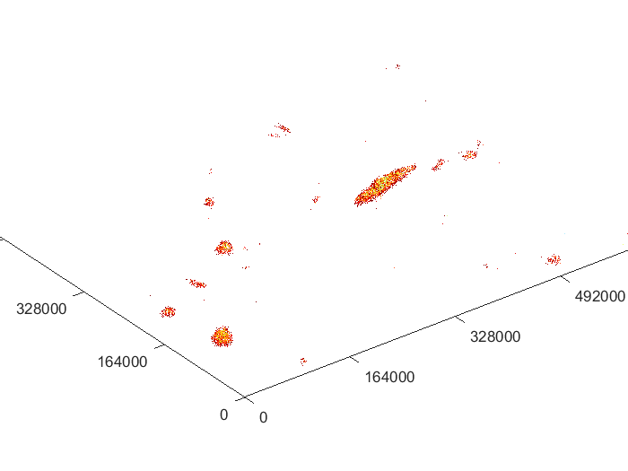
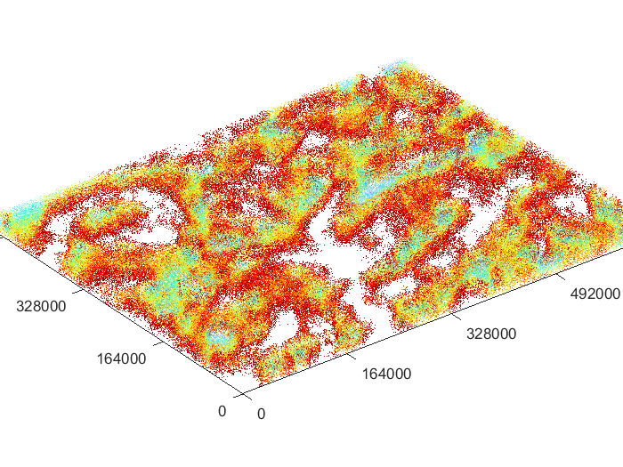
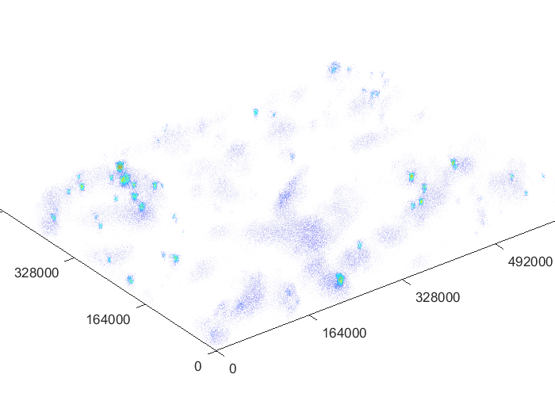
Intensity classification
RAf
2
1
3
1
2
3

Slide 15
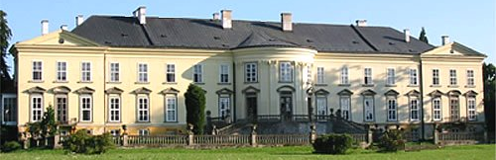
ACKNOWLEDGEMENT
Dalibor Štys, University of South Bohemia, CZ
Michael Fischer, Donau University, Krems, AT
Gero Kramer, Medical University, Vienna, AT
Georg Steiner, TissueGnostics, Vienna, AT
fa ImageCode
fa Optax
THANK YOU FOR YOUR ATTENTION

Slide 16
ACKNOWLEDGEMENT
Dalibor Štys
Jan Korbel
Michael Fischer
Tomáš Náhlík
fa ImageCode
fa TissueGnostics
fa Optax
THANK YOU FOR YOUR ATTENTION

